Slide 1
Comp3035 UML Class Diagrams
References
http://www.ibm.com/developerworks/rational/library/content/RationalEdge/sep04/bell/

Slide 2
Classification of UML Models/Diagrams
In UML 2 there are two basic categories of diagrams:
Structural Diagrams: model the static structure of the system.
Class diagram
Component diagram
Composite structure diagram
Deployment diagram
Object diagram
Package diagram
Profile diagram
Behavioral Diagrams: model the dynamic behavior between the objects in the system, including their methods, collaborations, and activities.
Activity diagram
Communication diagram
Interaction overview diagram
Sequence diagram
State diagram
Timing diagram
Use case diagram

Slide 3
The Class Diagram
Class diagram is a prime example of the structural models and provides us with an initial set of notation elements that all other structure diagrams use.
It describes the structure of a system by showing the system's classes, their attributes, operations (or methods), and the relationships among the classes.
Association
Generalization/Specialization
WHOLE-PART (Aggregation/Composition)
Elements of the Diagram
The UML representation of a class is a rectangle containing three compartments stacked vertically.
The top compartment shows the class's name.
The middle compartment lists the class's attributes.
The bottom compartment lists the class's operations.
The bottom two compartments are optional. (The bottom two would be unnecessary on a diagram depicting a higher level of detail in which the purpose is to show only the relationship between the classifiers.)

Slide 4
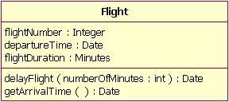
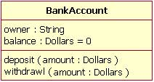
Some Class diagrams

Slide 5
Associations among Classes: Important Characteristics
Degree of Association: Unary, Binary, and Tertiary….N-iary
Multiplicity (Cardinality) of Association: One to Many, Many to Many
Optionality of Association: Student may enroll in one or more course

Slide 6
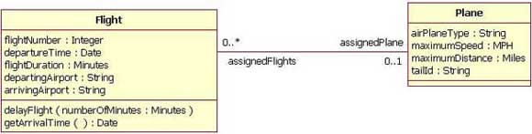
Associations among Classes: Types
1. Bi-directional Association
The default association is always Bi-directional which means that both classes are aware of each other and their relationship, unless you qualify the association as some other type.
A bi-directional association is indicated by a solid line between the two classes. At either end of the line, you place a role name and a multiplicity value

Slide 7
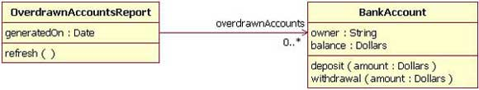
2. Uni-directional association
Two classes are related, but only one class knows that the relationship exists
A uni-directional association is drawn as a solid line with an open arrowhead (not the closed arrowhead, or triangle, used to indicate inheritance) pointing to the known class.
the OverdrawnAccountsReport knows about the BankAccount class, and the BankAccount class plays the role of "overdrawnAccounts."
However, unlike a standard association, the BankAccount class has no idea that it is associated with the OverdrawnAccountsReport.
[Note: It may seem strange that the BankAccount class does not know about the OverdrawnAccountsReport class. This modeling allows report classes to know about the business class they report, but the business classes do not know they are being reported on. ** Incompliance with the design principle of Coupling

Slide 8
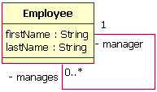
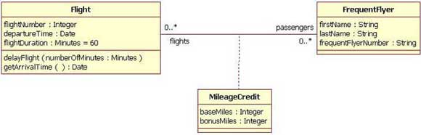
3. Association class/ Reflexive Associations
To show the attribute of the relationship we would use an association class.
An association class is represented like a normal class. The difference is that the association line between the primary classes intersects a dotted line connected to the association class.
When a class is associated to itself, this does not mean that a class's instance is related to itself, but that an instance of the class is related to another instance of the class.

Slide 9
Hierarchies in Class Diagrams
Generalization/Specialization
Whole-Part
Aggregation
Composition

Slide 10
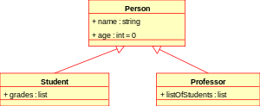
1. Generalization/Specialization Hierarchy
The Generalization/Specialization relationship ("is a") indicates that one of the two related classes (the subclass) is considered to be a specialized form of the other (the super type) and superclass is considered as 'Generalization' of subclass.
In practice, this means that any instance of the subtype is also an instance of the superclass.
An exemplary tree of generalizations of this form is found in binomial nomenclature: human beings are a subclass of simian, which are a subclass of mammal, and so on. The relationship is most easily understood by the phrase 'an A is a B' (a human is a mammal, a mammal is an animal).

Slide 11

2(a)- Aggregation
Aggregation is a special type of association used to model a "whole to its parts" relationship.
To represent an aggregation relationship, you draw a solid line from the parent class to the part class, and draw an unfilled diamond shape on the parent class's association end.
a) Basic aggregation relationships: the lifecycle of a part class is independent from the whole class's lifecycle.
For example, we can think of Car as a whole entity and Car Wheel as part of the overall Car.
The wheel can be created weeks ahead of time, and it can sit in a warehouse before being placed on a car during assembly. In this example, the Wheel class's instance clearly lives independently of the Car class's instance.
However, there are times when the part class's lifecycle is not independent from that of the whole class — this is called composition. Consider, for example, the relationship of a company to its departments. Both Company and Departments are modeled as classes, and a department cannot exist before a company exists. Here the Department class's instance is dependent upon the existence of the Company class's instance.

Slide 12

2(b)- Composition aggregation
The composition aggregation relationship is just another form of the aggregation relationship, but the child class's instance lifecycle is dependent on the parent class's instance lifecycle. The Figure shows a composition relationship between a Company class and a Department class, notice that the composition relationship is drawn like the aggregation relationship, but this time the diamond shape is filled.
a Company class instance will always have at least one Department class instance.
Because the relationship is a composition relationship, when the Company instance is removed/destroyed, the Department instance is automatically removed/destroyed as well.
Another important feature of composition aggregation is that the part class can only be related to one instance of the parent class (e.g. the Company class in our example).

Slide 13
Some Examples of class Diagrams
Reference: Object Oriented Systems Analysis and Design by Satzinger and Burd(2005)

Slide 14
Draw a class diagram, including minimum and maximum multiplicity for the following. The system stores information about two things: cars and owners.
A car has attributes for make, model, and year.
The owner has attributes for name and address.
Assume a car must be owned by one owner and an owner can own many cars, but an owner might not own any cars (perhaps she just sold them all, but we still want a record of her in the system). Cars could be of Three types (subclasses)sports car, sedan, and minivan with appropriate attributes

Slide 16
A faculty member usually teaches many course sections of a course, but in some semesters a faculty member may not teach any.
Each course section must have at least one faculty number teaching it, but sometimes multiple faculty members teach course sections.
Furthermore, to make sure that all course sections are similar, one faculty member is assigned as course coordinator to oversee the course, and each faculty member can be coordinator of many courses. Students may enroll in many course sections and receive a grade at the end of the term for every course that they have enrolled in

Slide 18
Customers may open multiple accounts in one of the many Branches of the Bank.
Accounts are of two types: Checking and Saving
There are special types of customers – personal and commercial. All customers have a name and mailing address. Commercial customers have additional attributes for credit rating, contact person, and contact person phone. Personal customers have attributes for home phone and work phone. Additionally, expand the model to show that the bank has multiple branches, and each account is serviced by one branch. Naturally, each branch has many accounts.

Slide 20
Real Estate Listing System
Helps sales agents to help their clients to list their properties for sale and also search suitable properties for the prospective buyers. Clients sign a contract with their agents to put up their properties for sale(listings). Every agent is associated with one of the real estate offices which forwards the listing information to the REL system.
Information on the listing includes the address of the property, year built, covered area(sqft), number of bedrooms, asking price, and status code.
Buyers agents might seek detailed information about any listing directly anytime including the sellers agent’s contact details.
Every Real estate office prints a listing book fortnightly which contains detailed information about all listings and these printed books are sent to all real estate agents (Some agents find it more convenient to use print outs viz a viz using online system). Owners may update a listing by contacting their agents who will then forward this change request to their offices and only the office staff would be authorized to make these changes in the system

Slide 22
State Patrol Ticket Processing system
State Patrol Ticketing Processing (SPTP) records traffic violation tickets, fines paid by drivers when they plead guilty or are found guilty of moving violations by the courts, and to notify the court that a warrant for arrest should be issued when such fines are not paid in a timely manner.
The SPTP system primarily creates and maintains ticket data and has the ability to extract and store officers, courts and drivers data from the respective databases.
Driver attributes include license number, name, address, date of birth, dates licensed and so on. Ticket attributes include unique ticket number, location, ticket type, ticket date, ticket time, plea, trial date, verdict, fine amount, and date paid. Court and officer date include the name and address of each. Each driver may have zero or more tickets and each ticket belong to one and only one driver. Officers write quite a few tickets daily.
When an officer issues a ticket to a driver, a copy of the ticket is turned in (online or postal mail) and entered in the system and therefore a new ticket record is created.
If the driver pleads guilty and pays the fine (online, telephone or via postal mail) and the system records guilty plea and that the fine has been paid. If the driver pleads not guilty and requests a court date, a trial request is sent to the appropriate court. The court schedules a trial date and informs the driver directly.
Upon completion of trial the court sends the verdict to the ticketing system. The verdict and trials date are recorded for the ticket. If the verdict is guilty, the court gives the driver another deadline to pay the fine and if the driver fails to pay the fine within that timeframe then SPSTP sends a warrant request to the court.

